Slide 1
Department of Computer Science and Engineering
Enhancing Security: A Deep Learning Approach for Automated Weapon Detection
PRESENTED BY
B. Pavan Dath 22475A0517
A. RajaVamsi 22475A0508
M. Venkata Sai 21471A05N7
Under the Guidance of,
DR. K. Suresh Babu Ph.D
Asst.Professor,
Department of Computer Science and Engineering,
Narasaraopeta Engineering College (Autonomous),
Narasaraopet- 522 601.

Slide 2
Content
Abstract
Introduction
Literature Survey
Research Gaps
Problem Statement
Objectives
Block Diagram
Methodology
Questions and Answers
Acknowledgement

Slide 3
Abstract
Aim: Develop a CNN-based model for automated weapon detection to enhance security applications.
Tools and Technologies Used: TensorFlow, Keras, OpenCV, Jupyter Notebook, and GPU acceleration for faster training.
Dataset: A curated dataset containing 1,019 labeled weapon images across eight categories, including rifles, handguns, and grenades.
Method:
Preprocessing: Image normalization and augmentation.
Feature Extraction: Pre-trained models (VGG16, ResNet50, ResNet101) alongside a proposed CNN architecture incorporating VGG19.
Model Training: Fine-tuning with transfer learning techniques.
Key Results: Achieved 99.77% accuracy, demonstrating superior performance in weapon classification. The model offers real-time detection capabilities, contributing to enhanced public safety and surveillance systems.

Slide 4
This project presents a deep learning approach to automated weapon detection, leveraging Convolutional Neural Networks (CNNs) for enhanced security applications.
The system employs pre-trained models (VGG16, ResNet50, and ResNet101) for feature extraction, alongside a proposed custom CNN architecture incorporating VGG19, enabling accurate classification of eight weapon categories, including rifles, handguns, and grenades.
The dataset consists of 1,019 labeled images, preprocessed and normalized for efficient model training. By fine-tuning pre-trained models and integrating transfer learning techniques, the custom CNN with VGG19 achieved superior performance, demonstrating 99.77% accuracy.
The study highlights the potential of deep learning for real-time weapon detection, offering significant advancements in public and private safety through scalable and efficient surveillance solutions. Ethical considerations are prioritized to ensure unbiased and responsible application of this technology.

Slide 5
Introduction
Weapon Detection is a crucial task in security and surveillance.
Motivation: Automating weapon recognition to enhance security and threat prevention.
Importance: Helps in real-time threat detection and response, reducing risks in public spaces.
Relevance: Applications in law enforcement, surveillance systems, and public safety monitoring.

Slide 6
This project explores a deep learning approach to enhance weapon detection in images using Convolutional Neural Networks (CNNs).
The enhanced detection system can be integrated into existing CCTV or security monitoring systems, offering a scalable and efficient way to monitor environments for potential threats.
This system enhances public and private security by enabling real-time weapon detection, reducing response times in critical situations.
The system can accurately identify weapons in images.

Slide 7
Our model provides a image classification job with type of weapon.
By training the model on the generated dataset, we can learn from it and use it to detect weapons.
We utilize pre-trained models (VGG16, ResNet50, ResNet101) along with a custom-designed CNN to classify images as containing weapons or not.
By eliminating manual monitoring, it increases accuracy and consistency, minimizing human error and ensuring faster threat detection.

Slide 8
Literature Review
No | Title | Author | Journal Name & year | Methodology Adopted | Key Findings | Gaps
1 | Malik, Rich Feature Hierarchies for Accurate Object Detection and Semantic Segmentation | R. Girshick, J. Donahue, T. Darrell, J. Malik. | https://doi.org/10.1109/CVPR.2014.81 | R-CNN (Regions with Convolutional Neural Networks). | High-capacity CNNs, Significant mAP, Pre-training and Fine-tuning, Rich Hierarchy of Features. | Slow detection speed
2 | Faster R-CNN: Towards Real-Time Object Detection with Region Proposal Networks | S. Ren, K. He, R. Girshick, J. Sun. | https://doi.org/10.1109/TPAMI.2016.2577031 | Region Proposal Network (RPN), R-CNN, VGG-16 model. | RPN generates efficient region proposals, improving Faster R-CNN's speed and accuracy. | Reliance on a fixed number of region proposals
3 | You Only Look Once: Unified, Real-Time Object Detection | J. Redmon, S. Divvala, R. Girshick, A. Farhadi, | https://doi.org/10.48550/arXiv.1506.02640 | Unified Architecture, Grid Division, Bounding Box Prediction, Non-Maximum Suppression. | Real-time speed, Unified model, Contextual reasoning, High mAP. | Struggles with accurately localizing small objects in images.
4 | Deep Residual Learning for Image Recognition | K. He, X. Zhang, S. Ren, J. Sun. | https://doi.org/10.1109/CVPR.2016.90 | Residual learning framework for deep networks, residual function reformulation. | Residual networks, ImageNet, ILSVRC, COCO detection. | Needing a lot of resources to train and run.
5 | Pedestrian detection with a Large-Field-Of-View deep network | A. Angelova, A. Krizhevsky and V. Vanhoucke | https://doi.org/10.1109/ICRA.2015.7139256 | Large-Field-Of-View (LFOV), Convolutional Architecture, Cascading Detection, Training and Proposal Generation. | Speed Improvement, High accuracy and Simultaneous Detection. | LFOV network is not yet real-time.
6 | Deep Residual Learning for Image Recognition | K. He, X. Zhang, S. Ren and J. Sun. | https://doi.org/10.1109/CVPR.2016.90 | Residual Learning Framework, Residual Block and Architecture. | Residual Learning Addresses Degradation, Deeper Networks are More Effective and Improved Performance. | increasing network depth beyond a certain point can lead to diminishing performance gains

Slide 9
RESEARCH GAPS
Limited Real-World Datasets:
Most existing weapon detection models rely on synthetic or limited datasets. There is a need for large-scale, diverse datasets that capture real-world variations in lighting, angles, and occlusions.
False Positives and False Negatives:
Current deep learning models sometimes misclassify objects (e.g., detecting toy guns as real weapons or missing concealed weapons). More robust techniques are required to reduce misclassification rates.
Detection in Crowded and Low-Visibility Environments:
Many weapon detection systems struggle in dense crowds, poor lighting, and occlusions (e.g., people partially covering weapons). Enhancing model robustness in such conditions is a challenge.

Slide 10
Real-Time Processing Constraints:
High-accuracy deep learning models (e.g., ResNet, VGG) often require powerful hardware, making real-time processing difficult on edge devices or CCTV systems. There is a need for lightweight yet accurate models.
Generalization Across Different Weapon Types:
Some models perform well for specific types of weapons (e.g., guns) but struggle to detect knives, blunt weapons, or concealed firearms. A more comprehensive approach is needed for multi-class weapon detection.
Integration with Security Systems:
While weapon detection models exist, seamless integration with surveillance systems, law enforcement databases, and alert mechanisms is still underdeveloped. More research is needed on real-time alert systems.

Slide 11
PROBLEM STATEMENT
Traditional security systems rely on human monitoring, leading to delays and errors in weapon detection.
A deep learning-based system can enhance real-time identification and classification of weapons.
Integrating CNN models ensures higher accuracy, reducing false alarms and enabling faster threat detection.

Slide 12
OBJECTIVES
Train the model with CNN architectures like VGG16 and ResNet.
Enhance real-time detection accuracy in surveillance footage.
Reduce human intervention and response time in security threats.
Improve classification of different weapon types in images.

Slide 13
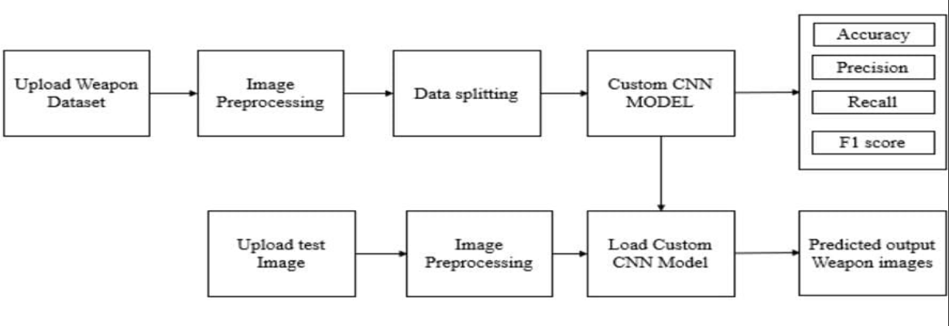
BLOCK DIAGRAM OR FLOW DIAGRAM

Slide 14
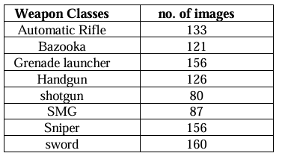
Methodology
Dataset includes 1019 labelled images
across 8 weapon classes: Automatic Rifle,
Bazooka, Grenade Launcher, Handgun,
Shotgun, SMG, Sniper, and Sword.
Images resized to 224x224 pixels for
compatibility with CNN models
(VGG16, ResNet50, ResNet101).
Pixel values normalized to [0,1] range by dividing by 255 for faster model convergence.
Pre-trained CNN models used: VGG16, ResNet50, and ResNet101,VGG fine-tuned for weapon detection.
Custom CNN and VGG19 architecture designed with convolutional, max-pooling, and dense layers, followed by a softmax output layer.
Custom CNN architecture designed with convolutional, max-pooling, and dense layers, followed by a softmax output layer.
Performance evaluated on test set using accuracy and loss.

Slide 15
TensorFlow: Used for building and training the Convolutional Neural Networks (CNNs).
Media and Libraries used
TensorFlow: Used for building and training the Convolutional Neural Networks (CNNs).
Keras: Simplified the use of pre-trained models like VGG16, ResNet50, and ResNet101.
NumPy: Supported numerical operations and array manipulations necessary for image processing and model inputs.
Scikit-learn: Used for splitting the dataset into training and testing sets with train_test_split function.
Matplotlib: Visualized training results, such as accuracy and loss over epochs.
JSON: Handled parsing of label data stored in JSON format.

Slide 16
Model Architecture and Training
VGG16, ResNet50, and ResNet101 pre-trained models were utilized. These models are widely recognized for their feature extraction capabilities, allowing efficient weapon detection in images.
In addition to pre-trained models, a custom Convolutional Neural Network (CNN) architecture was developed. It included convolutional layers, max-pooling, and fully connected layers tailored for weapon detection.
The detection pipeline initiates by adjusting the image size to match the model's input requirements. Following this, the pixel values are transformed, ensuring uniform data formatting and enhancing the model's ability to recognize features accurately across varying images
Fine-tune the pre-trained models for weapon detection using transfer learning.
Evaluate the models using accuracy and loss on the test set to measure how well the models detect weapons.
The study compared pre-trained CNNs (VGG16, ResNet50, ResNet101) with a custom CNN for weapon detection in images. Custom CNN performed best, demonstrating the effectiveness of deep learning for automated weapon identification in security applications.

Slide 17
IMPLEMENTATION
Software Specifications:
Operating System: Windows 10.
Programming Language: Python 3.8.
Libraries: TensorFlow, Keras, NumPy, Pandas, Matplotlib, Scikit-learn.
Development Tools: Jupyter Notebook for model training, VS Code for frontend
Hardware Specifications:
Processor: Intel Core i7.
RAM: 16 GB.
Storage: 512 GB SSD.
GPU: NVIDIA GeForce GTX 4060(for training the CNN model).

Slide 18
IMPLEMENTATION
Collected and preprocessed the dataset by resizing and normalizing images for consistency.
Used data augmentation techniques to enhance model generalization.
Trained a CNN-based model with TensorFlow and Keras for feature extraction.
Fine-tuned the model using transfer learning with pre-trained architectures like ResNet or VGG.
Deployed the trained model using Flask, providing a REST API for real-time predictions.
Integrated OpenCV for real-time video processing and object detection.
Optimized the model for faster inference using TensorRT or ONNX for deployment.

Slide 19
Model Evaluation
The models were evaluated using accuracy and loss.
Accuracy shows how many images were correctly classified and type of weapon.
Loss measures the error in predictions, with lower loss indicating better performance.
Evaluate the models using accuracy and loss on the test set to measure how well the models detect weapons.
Custom CNN had the best performance compared to VGG16, ResNet50, and the ResNet101 .
A confusion matrix was used to check how well the models classified different types of weapons, with some challenges in distinguishing visually similar weapons.

Slide 20
Weapon Detection
Weapon detection involves using trained Convolutional Neural Networks (CNNs) to classify type of weapon.
The detection process starts with resizing the image to 224x224 pixels, followed by normalization (scaling pixel values to the range [0,1]) to ensure consistent input for the models.
After preprocessing, the image is fed into the trained CNN models (VGG16, ResNet50, ResNet101, or the custom CNN).
The model generates a probability score indicating the likelihood of the image containing a weapon.
If the probability exceeds a specified threshold, the image is classified as containing a weapon and type of weapon.
This method helps automate weapon detection and enhances security by providing quick and accurate classification of images.

Slide 21
Ethical Consideration
Ethical considerations were prioritized throughout the model development process.
The dataset was designed to be inclusive and unbiased, minimizing any discriminatory impact or biased results.
The primary goal of this system is to promote the responsible use of technology for safety and surveillance purposes.
The study took into account the potential social implications of weapon detection technology, aiming to enhance public and private security without infringing on privacy or personal freedoms.

Slide 22
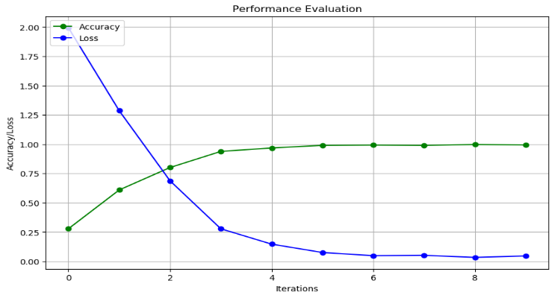
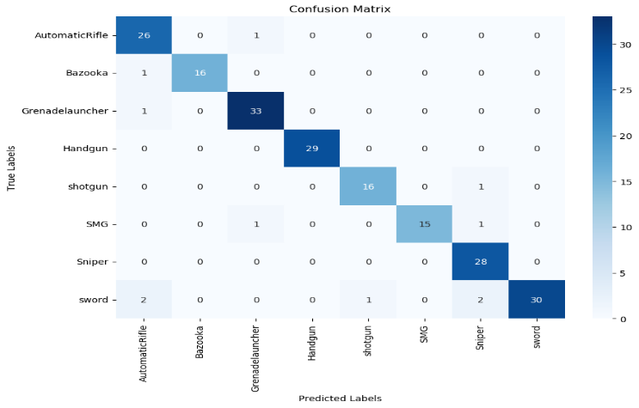
Results and Analysis
Fig1: Accuracy Graph for Cusom Cnn
Fig 2: Confusion Matrix of Custom CNN

Slide 23
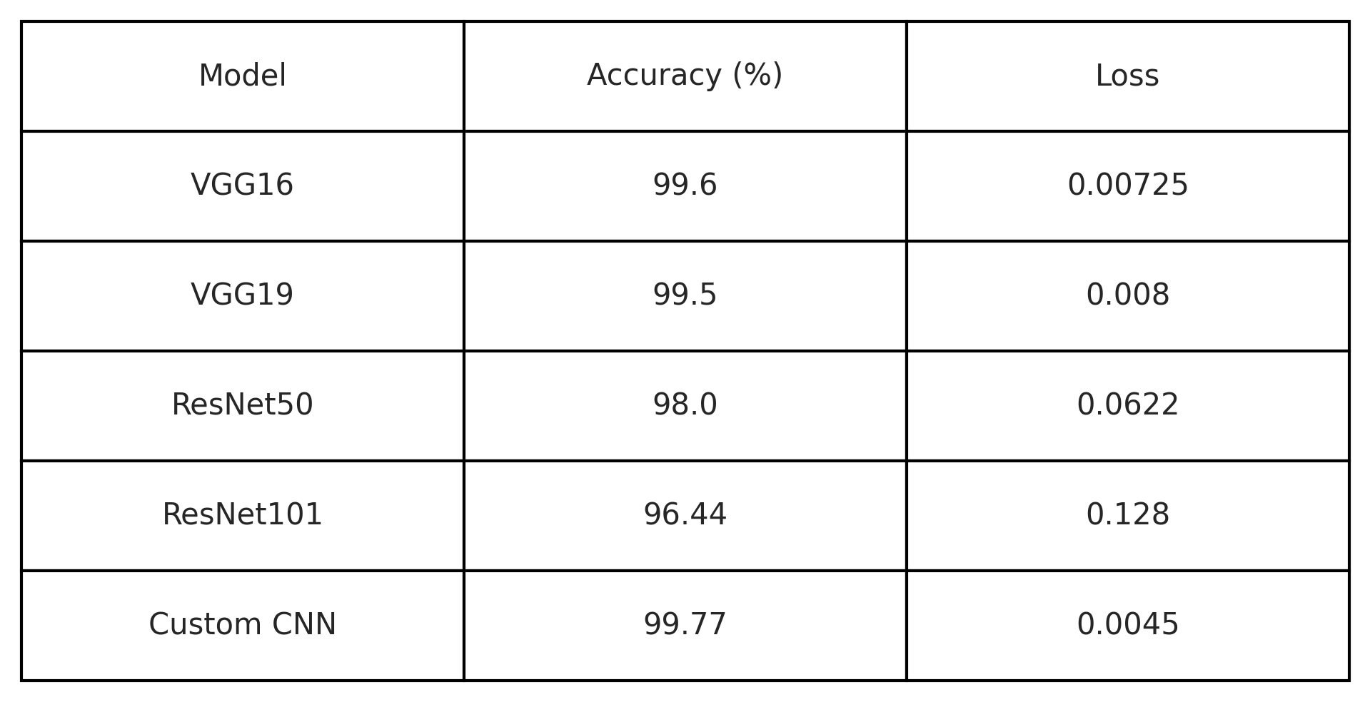
Results and Discussions
Table 1: Results Table

Slide 24
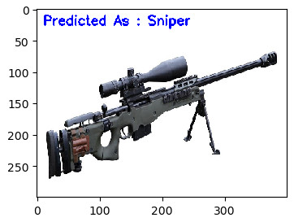
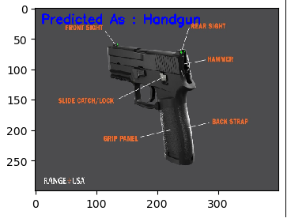
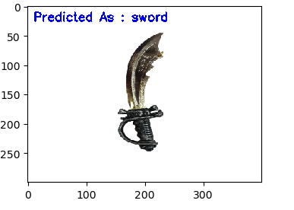
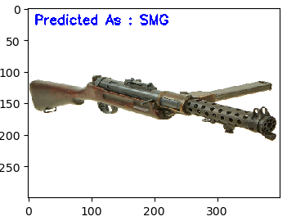
Output:

Slide 25
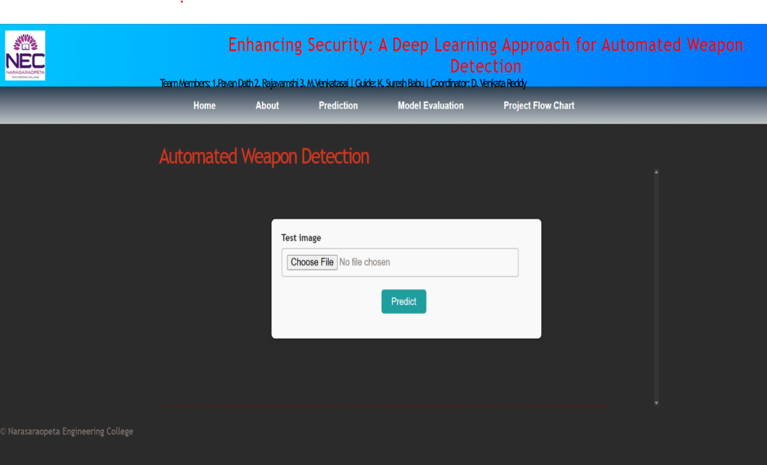
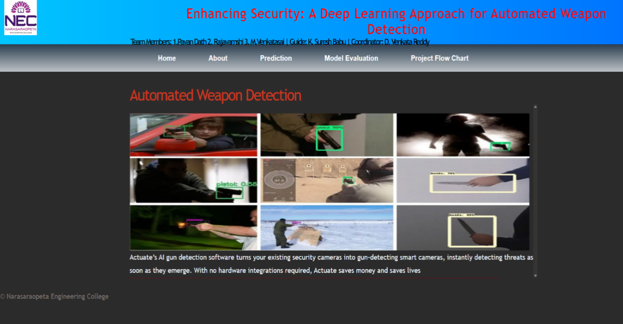
Screens
Predict Screen
Home Screen

Slide 26
Conclusion
The study demonstrated high accuracy in weapon detection using custom CNNs outperforming other models, achieving 99.77% accuracy.
Custom CNN generally performed better than the Pre-trained models (VGG16, ResNet50, ResNet101), highlighting the benefits of transfer learning.
The system shows promise for enhancing security in various settings through automated weapon detection in images.
Potential improvements include expanding the dataset, optimizing for real-time detection, developing multi-class weapon classification, and deploying the system in real-world security environments.

Slide 27
FUTURE SCOPE
Future Scope:
Expanding the dataset with more diverse genres and real-world music samples can improve the model's generalization. Incorporating advanced audio features like spectral contrast, chroma features, and tonnetz can enhance classification accuracy.
Optimizing the model using deep learning architectures such as ResNet, Transformers, or CNN may further improve performance.
Implementing real-time classification in a music streaming application can make the model more practical.

Slide 28
QUESTIONS & ANSWERS
Feel free to ask any questions regarding the project methodology, implementation, or results.
I will be happy to provide further clarifications or insights on any specific aspect of the project.

Slide 29
ACKNOWLEGEMENTS
I sincerely thank my guides, mentors, and colleagues for their invaluable support and guidance throughout this project.
I am grateful to Narasaraopeta Engineering College for providing the resources and opportunity to work on this challenging project.
Special thanks to my peers and reviewers for their constructive feedback and encouragement.
Team:DB 13 Name: B. Pavan Dath ( 22475A0517) A. RajaVamsi (22475A0508) M. Venkata Sai (21471A05N7)

Slide 30
References
G. Raturi, P. Rani, S. Madan and S. Dosanjh, ADoCW: An Automated method for Detection of Concealed Weapon, 2019 Fifth International Conference on Image Information Processing (ICIIP), Shimla, India, pp. 181-186 (2019).
A. Warsi, M. Abdullah, M. N. Husen and M. Yahya, Automatic Handgun and Knife Detection Algorithms: A Review, 2020 14th International Conference on Ubiquitous Information Management and Communication (IMCOM), Taichung, Taiwan, pp. 1-9 (2020).
Z. Gong, P. Zhong, Y. Yu, W. Hu and S. Li, "A CNN With Multiscale Convolution and Diversified Metric for Hyperspectral Image Classification," in IEEE Transactions on Geoscience and Remote Sensing, 57, pp. 3599-3618, June (2019).
J. Tao, Y. Gu, J. Sun, Y. Bie and H. Wang, "Research on vgg16 convolutional neural network feature classification algorithm based on Transfer Learning," 2021 2nd China International SAR Symposium (CISS), Shanghai, China, pp. 1-3, (2021).
C. Shorten, Introduction to resnets. Towards Data Science, A Medium publication sharing concepts, ideas, and codes (2019).
M. Molinier and J. Kilpi, "Avoiding Overfitting When Applying Spectral-Spatial Deep Learning Methods on Hyperspectral Images with Limited Labels," IGARSS 2019 - 2019 IEEE International Geoscience and Remote Sensing Symposium, Yokohama, Japan, pp. 5049-5052 (2019).
M. Molinier and J. Kilpi, "Avoiding Overfitting When Applying Spectral-Spatial Deep Learning Methods on Hyperspectral Images with Limited Labels," IGARSS 2019 - 2019 IEEE International Geoscience and Remote Sensing Symposium, Yokohama, Japan, pp. 5049-5052 (2019).
N. Dwivedi, D. K. Singh and D. S. Kushwaha, Weapon Classification using Deep Convolutional Neural Network, 2019 IEEE Conference on Information and Communication Technology, Allahabad, India, pp. 1-5 (2019).
Y. Aslam and S. N, "A Review of Deep Learning Approaches for Image Analysis," 2019 International Conference on Smart Systems and Inventive Technology (ICSSIT), Tirunelveli, India, pp. 709-714, (2019).

Slide 31
Thank You…

